Slide 1
End of Slavery & Jim Crow

Slide 2
How did slavery end?
There was a civil war between the northern states (against slavery) and the southern states (wanted slavery)
The North WON!

Slide 3
Reconstruction
During reconstruction (the period following the Civil War) many blacks exercised these rights (voted and held office)

Slide 4
1865 – Reconstruction Begins
13th Amendment: Abolished slavery
14th Amendment: Equal protection under the law to all U.S. citizens
15th Amendment: Cannot deny rights based on race
Freedman's Bureau: Provided food, clothing, hospitals, help with employment, and schools for blacks in the South

Slide 5
Hiram Revels
Born a free black
Preacher and later college president
First black ever elected to Congress (from MS)

Slide 6
Blanche K. Bruce
Born in slavery to a house slaves and her master
He was taught to read with the master’s son
Senator from Mississippi
He was the first black to serve a full term

Slide 7
Now that blacks had equal rights, why didn’t they use them?

Slide 8
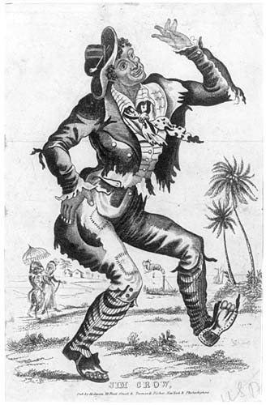
Jim Crow Laws - laws passed by southerners to segregate public places, such as schools, restaurants, theaters, trains, hospitals, water fountains, and cemeteries.
The "Jim Crow" figure was a fixture of the minstrel shows that toured the South; a white man made up as a black man sang and mimicked stereotypical behavior in the name of comedy.
Jump Jim Crow, Bob Ekstrand, 2:05
Get Off the Sidewalk Charles Gratton, 2:17

Slide 9
Black Codes -
laws that severely limited the rights of freedmen.
…serving on juries.
…voting.
African-Americans were forbidden from…
…owning guns.
…running for political office.

Slide 10
Poll tax
Requiring voters to pay a tax to be able to vote
Most blacks were poor and could not afford this

Slide 11
Literacy Test
Tests that required voters to be able to read or write certain information to be able to vote
This was bad because many blacks didn't know how to read that well

Slide 12
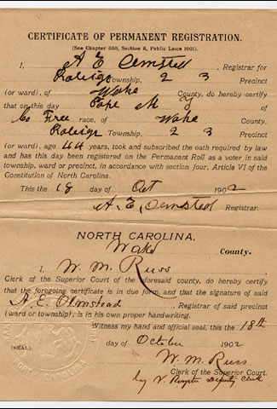
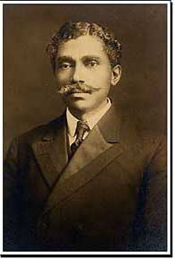
Grandfather Clause
In order to help poor, illiterate whites to vote, a grandfather clause was passed.
It stated that if a voter’s father or grandfather was eligible to vote on January 1, 1867, they did not have to take a literacy test.
This allowed whites to vote, but not freedmen.
Dr. Manassa Thomas Pope was able to receive a voter registration card because his parents had been freed prior to 1867. He was one of only seven black voters in Raleigh and one of 31 in all of Wake County, NC.

Slide 13
Sample Jim Crow Laws
Florida: The schools for white children and the schools for negro children shall be conducted separately.
Virginia: Any public hall, theatre, opera house, motion picture show or place of public entertainment which is attended by both white and colored persons shall separate the white race and the colored race.
Maryland: All railroad companies are hereby required to provide separate cars or coaches for the travel and transportation of the white and colored passengers.
Louisiana: Any person...who shall rent any part of any such building to a negro person or a negro family when such building is already in whole or in part in occupancy by a white person or white family shall be guilty of a misdemeanor.
Florida: All marriages between a white person and a negro, or between a white person and a person of negro descent to the fourth generation inclusive, are hereby forever prohibited.

Slide 14
"Black Codes" of Mississippi – 1865
Section 3. …it shall not be lawful for any freedman, free negro or mulatto to intermarry with any white person; nor for any person to intermarry with any freedman, free negro or mulatto; and any person who shall so intermarry shall be deemed guilty of felony, and on conviction thereof shall be confined in the State penitentiary for life;
Section 5. Every freedman, free negro and mulatto shall…have a lawful home or employment, and shall have written evidence thereof…if living in any incorporated city, town, or village, a license from that mayor thereof; and if living outside of an incorporated city, town, or village, from the member of the board of police of his beat, …which license may be revoked for cause at any time by the authority granting the same.
Section 6. All contracts for labor made with freedmen, free negroes and mulattoes for a longer period than one month shall be in writing…and if the laborer shall quit the service of the employer before the expiration of his term of service, without good cause, he shall forfeit his wages for that year up to the time of quitting.

Slide 15
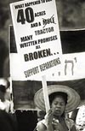
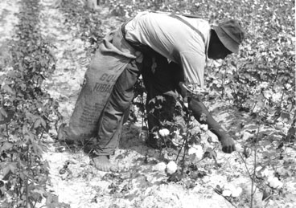
Sharecropper
· Some Radical Republicans wanted to give each freedman “40 acres and a mule”. However, all the freedmen were given was their freedom.
Sharecropper - farmer who works part of the land and gives the landowner part of the harvest
Southern sharecropper picking cotton.

Slide 16
How did sharecropping work?
· Freedmen would farm land belonging to white owners, oftentimes their old masters.
Plantation
Land worked by sharecroppers.
· Freedmen would pay rent for the land they farmed by giving the landowner a percentage of their crops.
· In addition, freedmen would purchase seed, tools, and other supplies from the landowner.
* As a result, freedmen were in constant debt to the landowners and were never able to earn a profit. If they tried to move, they could be arrested. Therefore, freedmen became tied down to the land, in a state similar to slavery.

Slide 17
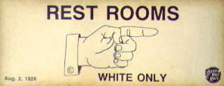
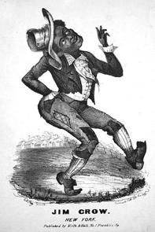
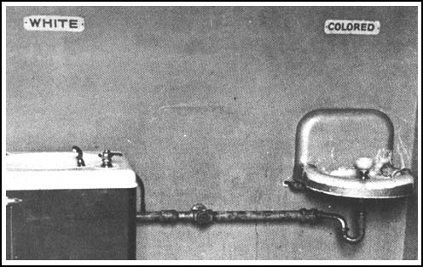
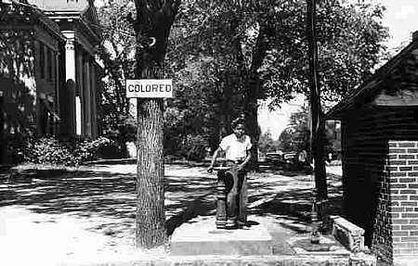

Slide 18
Jim Crow Laws

Slide 19
Jim Crow Laws

Slide 20
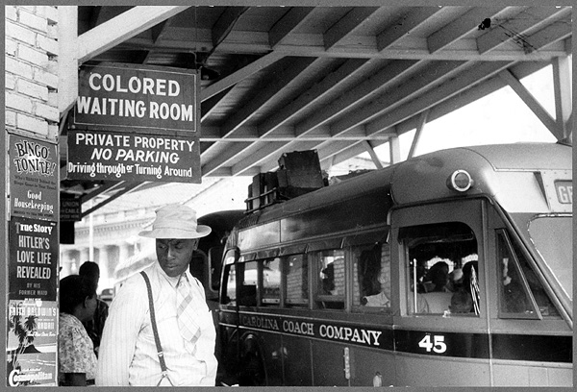
At the bus station, Durham, North Carolina, 1940.

Slide 21
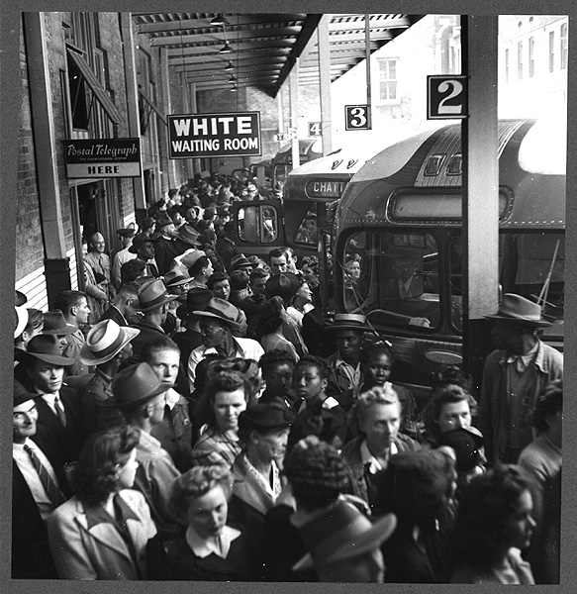
Greyhound bus terminal, Memphis, Tennessee. 1943.

Slide 22
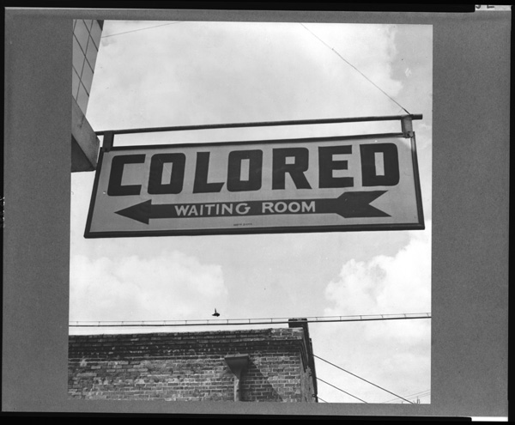
A sign at bus station, Rome, Georgia. 1943.

Slide 23
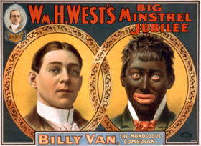
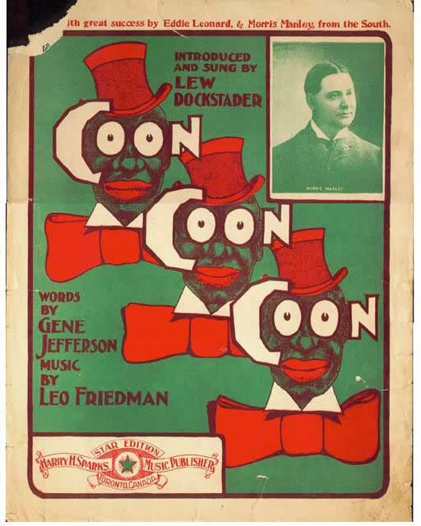
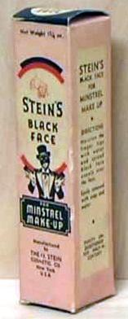
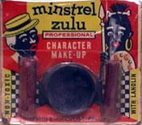

Slide 24
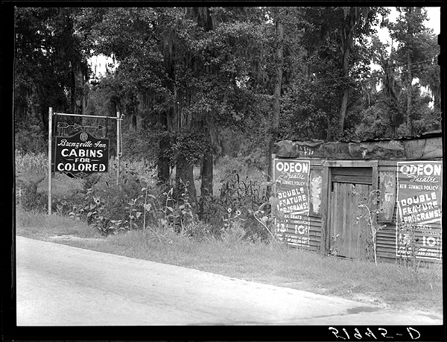
A highway sign advertising tourist cabins for Blacks, South Carolina. 1939.

Slide 25
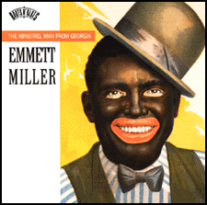
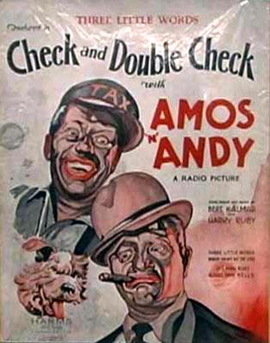
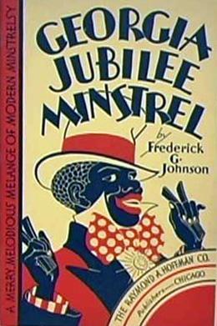

Slide 26
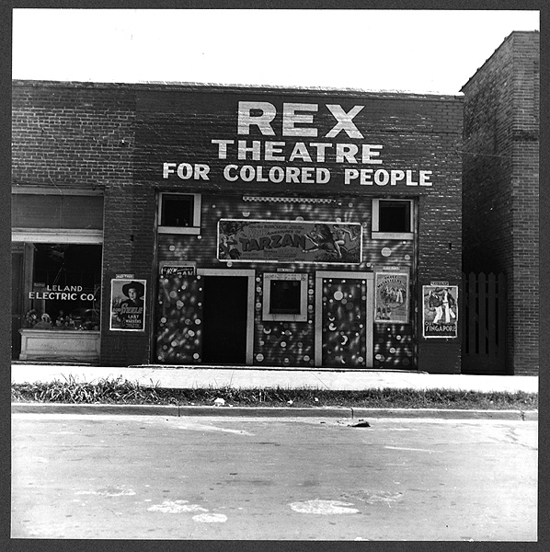
The Rex theater for colored people, Leland, Mississippi. June 1937.

Slide 27
Restaurant, Lancaster, Ohio. 1938.

Slide 28
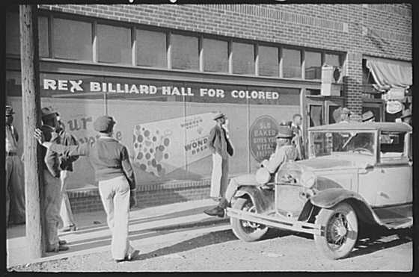
Beale Street, Memphis, Tennessee. 1939.

Slide 29
Plessy vs. Fegurson
Black man (Homer Plessy) sued that separate trains for blacks and whites were against the law
The Supreme Court decided in Plessy vs. Ferguson that separate institutions are okay if they are equal.

Slide 30
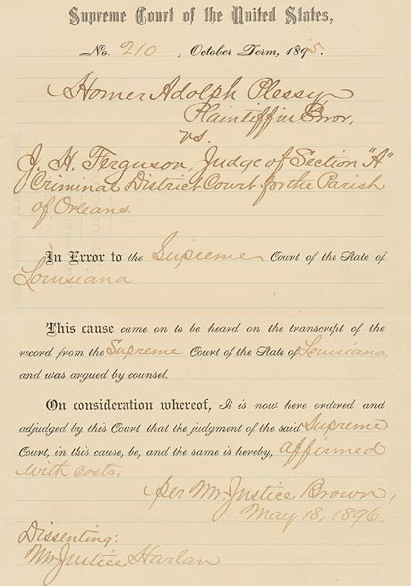
Plessy v. Ferguson - The Supreme Court ruled that segregation was legal as long as facilities were “separate but equal”.
This cause came on to be heard on the transcript of the record from the Supreme Court of the State of Louisiana, and was argued by counsel.
On consideration whereof, It is now here ordered and adjudged by this Court that the judgement of the said Supreme Court, in this cause, be and the same is hereby, affirmed with costs.

Slide 31
Some Facilities that Were Separate:
Bus station waiting rooms and ticket windows
Railroad cars or coaches
Restaurants and lunch counters
Schools and public parks
Restrooms and water fountains
Sections of movie theaters
There were even separate cemeteries

